Slide 1
HYPOTHESIS TESTING
By Silver Keny-Rambaei
Email:silverkeny@mu.ac.ke

Slide 2
Important terminologies
Population: The entire set of individuals about which findings of a survey refer to.
Sample: A subset of population selected for a study.
A parameter is a number that describes some aspect of a population.
A statistic is a number that is we usually have a sample statistic and want to use it to make inferences about the population parameter computed from data in a sample.
n
Statistical inference: is the process of drawing conclusions about the population based on sample information. There are two forms of statistical inference
  Hypothesis testing
  Estimation

Slide 3
Point Estimate
We use the statistic from a sample as a point estimate for a population parameter.
Point estimates may not be exactly as the population parameters, but they are the best guess, given the data
Sampling Distribution
A sampling distribution is the distribution of sample statistics computed for different samples of the same size and from the same population

Slide 4
Standard Error
The standard error (SE) of a statistic is the standard deviation of the sampling distribution of a statistic. The standard error measures how much the statistic varies from sample to sample
Interval estimation.
Is an interval within which we expect the population parameter to lie with some level of confidence
Margin of Error
Gives an interval estimate. It is the range of values above and below the sample statistics in confidence interval

Slide 5
Confidence Interval
A confidence interval for a parameter is an interval computed from sample data by a method that will capture the parameter for a specified proportion of all samples for example a 95% confidence interval will contain the true parameter within 95% of the area.

Slide 6
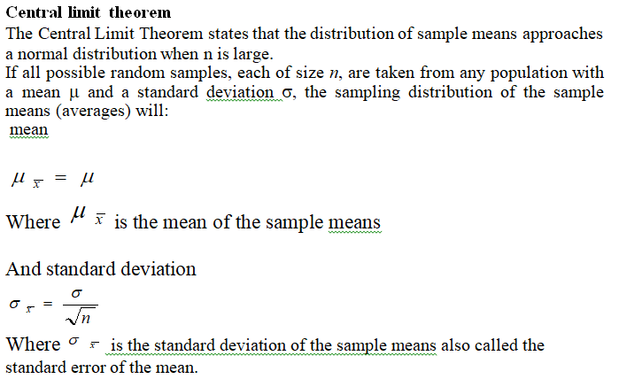

Slide 7
A hypothesis is a supposition, claim or statement about a population characteristic.
It is an assumption that is made about parameter values and its validity is tested by statistical technique which ultimately tell us whether the hypothesis is rejected or accepted
A hypothesis test (or test of hypothesis) is a procedure for testing a claim about a property of a population. Is a set of procedures for drawing conclusions about the population parameter based on information contained in a sample

Slide 8

TYPES OF ERRORS IN HYPOTHESIS TESTING
At the end of the test, one of two decisions will be made:
Either reject the null hypothesis, or fail to reject the null hypothesis and in making these decisions, we are bound to commit some errors called type I and type II
A type I error occurs if the null hypothesis is rejected when it is true.
A type II error occurs if the null hypothesis is not rejected when it is false.

Slide 9
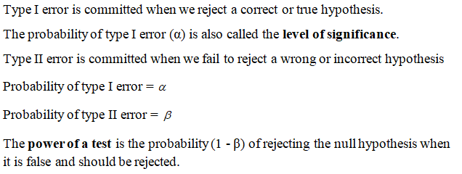

Slide 10
TWO TAILED AND SINGLE TAILED TEST OF HYPOTHESIS
A test of hypothesis is said to be two tailed if the rejection region falls on both sides of the normal distribution
A test of hypothesis is said to be single or one tailed if the rejection region falls on one side of the normal distribution ( right tailed test if it falls on the right and left tailed test if it falls on the left

Slide 11
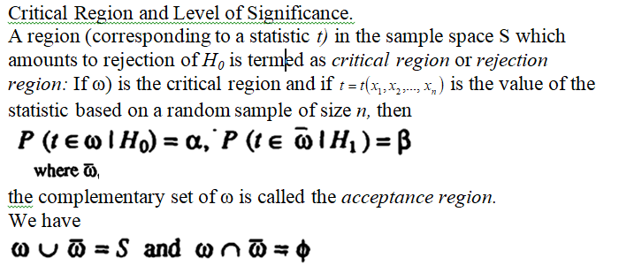

Slide 12
Critical Values or Significant Values.
The value of test statistic which separates the critical (or rejection) region and the acceptance region is called the critical value or significant value. It depends upon:
The level of significance used, and
The alternative hypothesis, whether it is two-tailed or single-tailed.

Slide 13
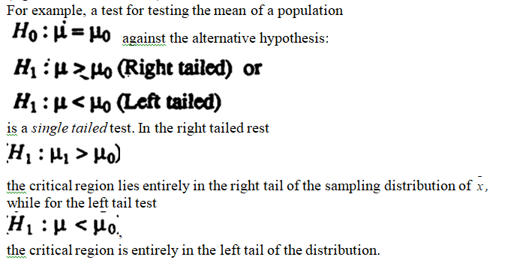

Slide 14
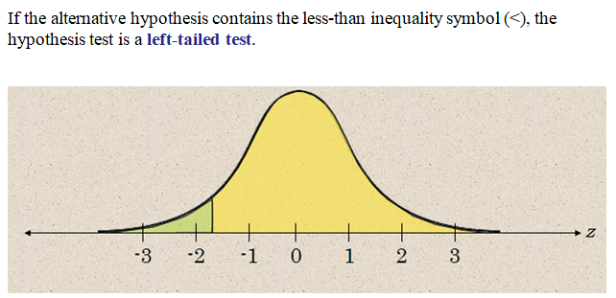

Slide 15
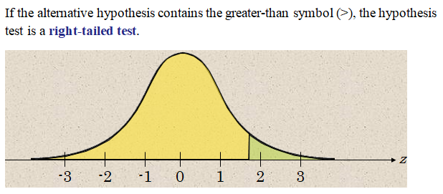

Slide 16
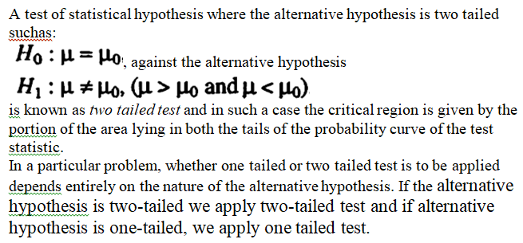

Slide 17
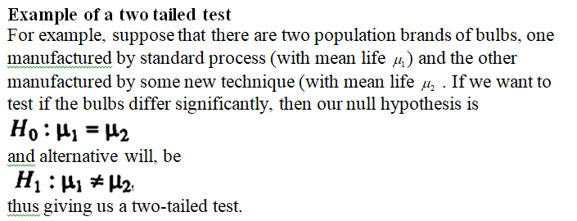

Slide 18
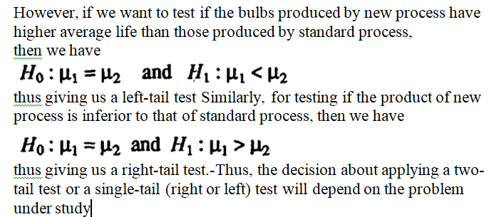

Slide 19
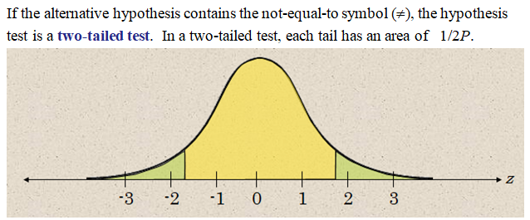

Slide 20
Steps in hypothesis testing
Making statement of hypothesis
Determining the level of significance
Test criterion and performing calculations
Decision making
Conclusion

Slide 21
Steps in hypothesis testing cont.
Setting up of a hypothesis. We usually have two complementary hypotheses:
A null hypothesis denoted by H₀ which is a hypothesis that contains a statement of equality such as ≤, =, or ≥ is also called a hypothesis of no difference and is usually tested for possible rejection
An alternative hypothesis H_{a} is the complement of the null hypothesis. It is a statement that is true if H₀ is false and vice versa. It contains a form of inequality such as >, ≠, or <.

Slide 22
Steps in hypothesis testing cont.
2. Level of Significance.
Level of significance is the maximum allowable probability of making a type I error. It is denoted by α, the lowercase Greek letter alpha.
Commonly used levels of significance
α = 0.10, α = 0.05 and α = 0.01

Slide 23
Test criterion or test statistic
Statistics of samples ( large samples)
Statistics of samples (small samples)
Statistics of attributes
Chi- square test
F test
The statistics tests are based on the calculation of standard error
Once we decide on the test criterion, we do computations

Slide 24
Decision making
A decision is made whether to reject or fail to reject the null hypothesis by comparing the calculated value of the statistic and some tabulated value or a p value
Conclusion
Once a decision is made, conclusion is made appropriately

Slide 25
Some of the material was borrowed from
S.C. Gupta and V.K. Kapoor (2002). Fundamentals of Mathematical Statistics, Sultan Chand & Sons Educational Publishers, New Delhi
D. N. Elhance and Veena Elhance. Fundamentals of Statistics

